Slide 1
"Become an impacting leader who can drive meaningful change"

Slide 2
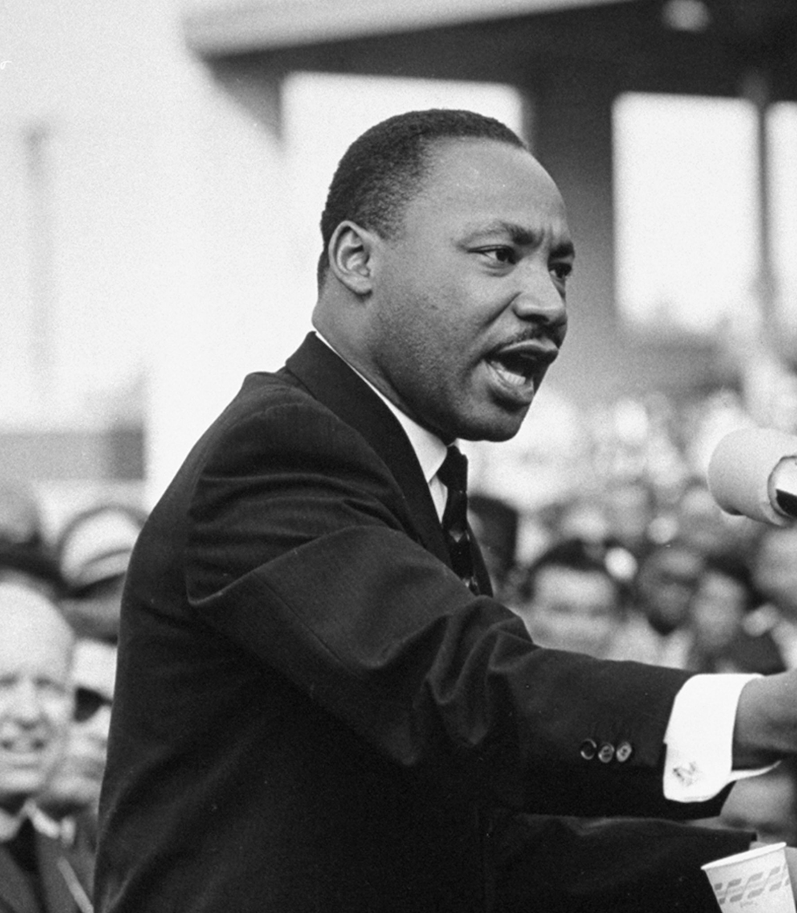
Who wants to make a difference in life?

Slide 3
Many people want to change the world, but few know how to do it. If you want to change the world, you have to change yourself first, and that is often the most difficult thing to do.

Slide 4
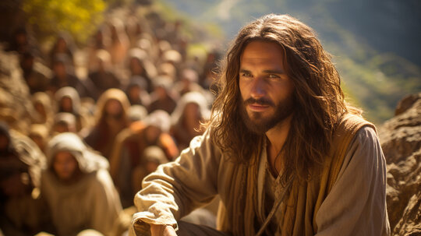
Jesus was the one, who had the most effective impact on the world

Slide 5
A dispute also arose among them, as to which of them was to be regarded as the greatest. And he said to them, “The kings of the Gentiles exercise lordship over them, and those in authority over them are called benefactors.
But not so with you. Rather, let the greatest among you become as the youngest, and the leader as one who serves.
For who is the greater, one who rests at the table or one who serves? Is it not the one who rests at the table? But I am among you as the one who serves.
Luk 22:24-27

Slide 6
Leadership is not about a position is about serving people

Slide 7
Phil 2.5-9: complete my joy by being of the same mind, having the same love, being in full accord and the same purpose in life.
1. Do nothing from selfish ambition or conceit, but in humility count others more significant than yourselves.
2. Let each of you look not only to his own interests, but also to the interests of others. Have this mind among yourselves,
3. He was in the form of God, but emptied himself, by taking the form of a servant, being born in the likeness of men, and humbled himself by becoming obedient to the point of death, even death on a cross.
4. Therefore, God has highly exalted him and given on him the name that is above every name.

Slide 8
1 Principle of leadership It is not about me Phil 2.5-9
Have a learning attitude: Have a great mentor (Jesus). Have the same attitude the same love and the same purpose in life.
It is not about me. Leadership can be measured by how much you see others and not yourself. It is not about my impute, my career, my performance, my time, my money, my profit. It is not about that I win; I am the first, I am the best. I want to stay in front be seen be heard. My rights my position, my health, I my me myself, please God bless all of us
Be ready to add value to people
Be willing to sacrifice your position You know I was born for something higher than just myself

Slide 9
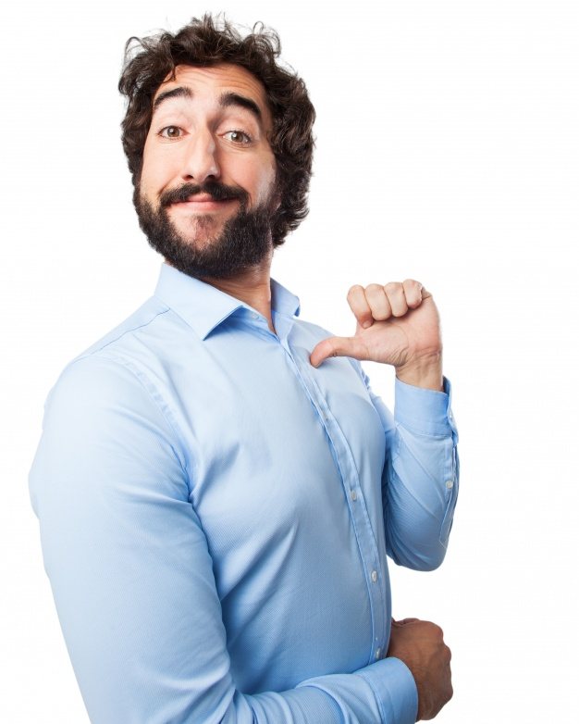
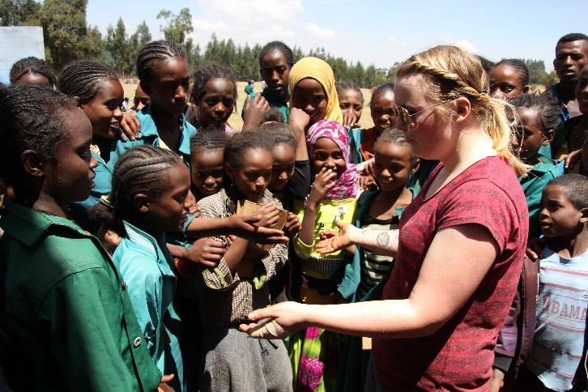
What do you think which picture would fit the best to leadership?

Slide 10
Leadership principle 1
To see the other more than yourself

Slide 11
2 Principles of Leadership It is all about me Phil 2.5-9
Leaders do things that nobody else is doing. When people can do it by themselves, then they don’t need a leader.
Leaders believe things, see things and do things that others do not do.
They do not blame others but take responsibility. Change only happens when we change something.
Leaders don’t wait for change; they are creating it.
A leader shows up with problems. He is not hiding when problems arise.
And God will lift him. He is willing to give up his position to receive a higher position.

Slide 12
There are three types of Leaders
Those who do not what they should do
Those who do what they have to do
Those who do a little bit more

Slide 13
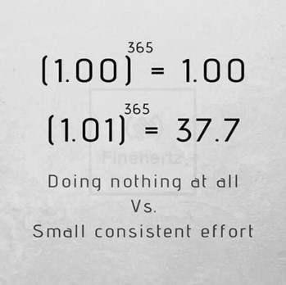
Leadership math
(1.00)x(1.00)x(1.00)x(1.00)x(1.00)x(1.00)x(1.00)x(1.00)x……..= 1.00

Slide 14
Leaders are born to bring change
Before you don’t ask the question, what can I change that change can happen - nothing will change.
As long you want to have just a position – nothing will change
As long you are seeing just you, I, me, my, mine – nothing will change
Before you do stand up and say, I am taking responsibility - nothing will change.
As long you want to be sure about the outcome and are not willing to take risks, nothing will change
As long you think life is easy nothing will change.
As long you are not willing to pay the price- nothing will change

Slide 15
The test about your leadership level
How much do I grow? How much am I willing to learn and be changed? Leadership is not about winning it is about growing.
How much am I willing to take responsibility? When nobody raises their hands, nothing will change.
How much can I see others instead of just myself? Leadership is not about a position it is about helping people.

Slide 16
Take responsibility
Receive a win-win mindset
Be able to work in a team. Understand the energy of synergy
Be a servant leader
Help others to become leaders

Slide 17
Php 4:9 What you have learned and received and heard and seen in me practice these things, and the God of peace will be with you.

Slide 18
Why was Paul so secure and confident?

Slide 19
Why was Paul so secure and confident?
It was not about himself
He had an attitude of Jesus

Slide 20
If you are not able to say, follow me you are not a leader.

Slide 21
Reality
Do not try to change your behavior
Behaviour
Values
Heart believes Identity
Thinking

Slide 22
Change your direction
Our mind just justifies what our hearts already decided. Everybody have a worldview. To think to be neutral is an illusion
Have the humbleness to test your hearts and beliefs? If you are not able to criticize what you love, you know and what you stay for, you cannot grow
Renew our minds to be able to live what is good Testing your belief according to the bible, every day.

Slide 23
Conclusion
To become a leader with influence a mindset change is required. We have to understand our minds and have to learn to think like the creator.

